Slide 1
Navigating the Armatus® Learn to Protect System
June 18, 2016

Slide 2

Navigating the Armatus Learn® to Protect System
Accessing Armatus
Courses Overview
Monitoring Compliance

Slide 3
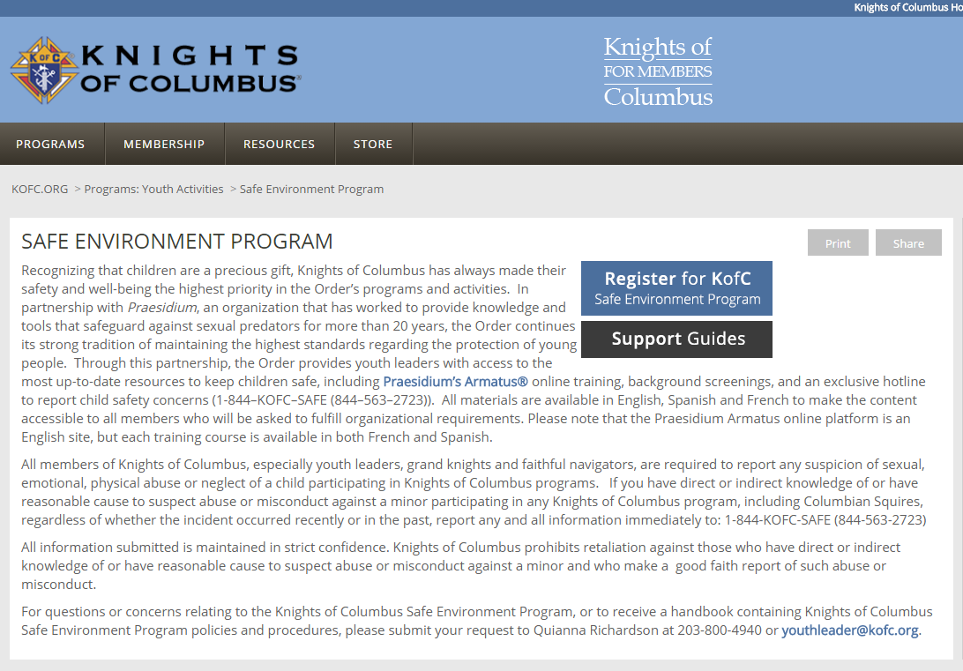
Accessing Armatus

Slide 4
Accessing Armatus
Username = Member Number + Last Name
1234567clarke
Password = kofcsafe
You will be required to update your password upon logging in for the first time.

Slide 5
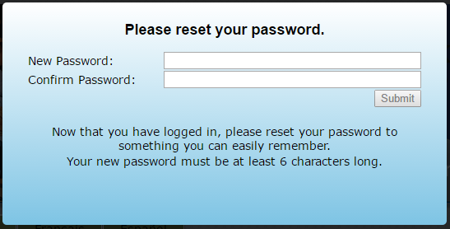
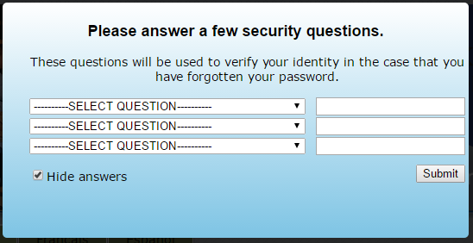
Accessing Armatus

Slide 6
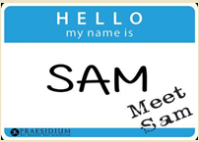


Courses Overview
Notes:
Courses available in English, Spanish and Canadian French
Each courses shows the status of Pending or Completed with completion date

Slide 7
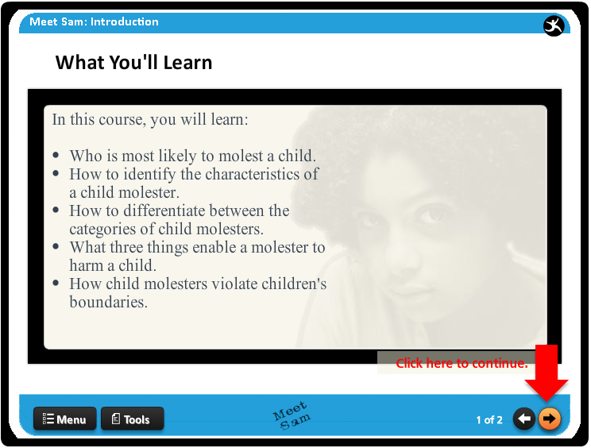
Courses Overview
Notes:
Courses available in English, Spanish and Canadian French
Each courses shows the status of Pending or Completed with completion date

Slide 8
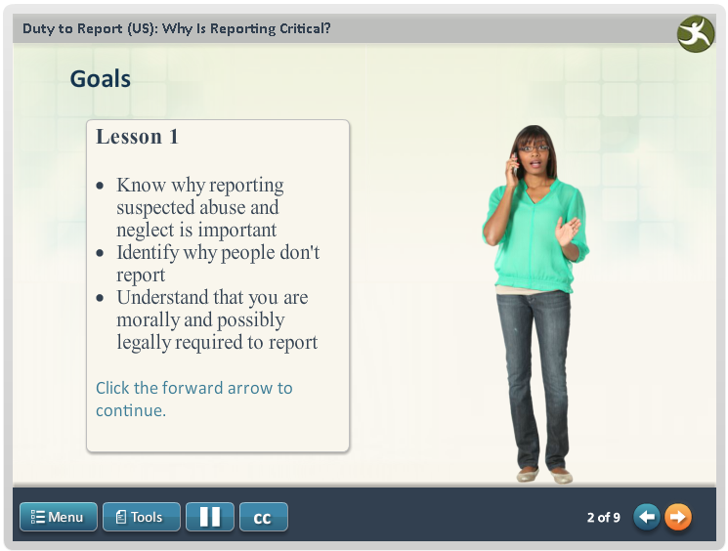
Courses Overview Duty to Report: Mandated Reporter
Notes:
Courses available in English, Spanish and Canadian French
Each courses shows the status of Pending or Completed with completion date

Slide 9

Courses Overview
Notes:
Courses available in English, Spanish and Canadian French
Each courses shows the status of Pending or Completed with completion date

Slide 10
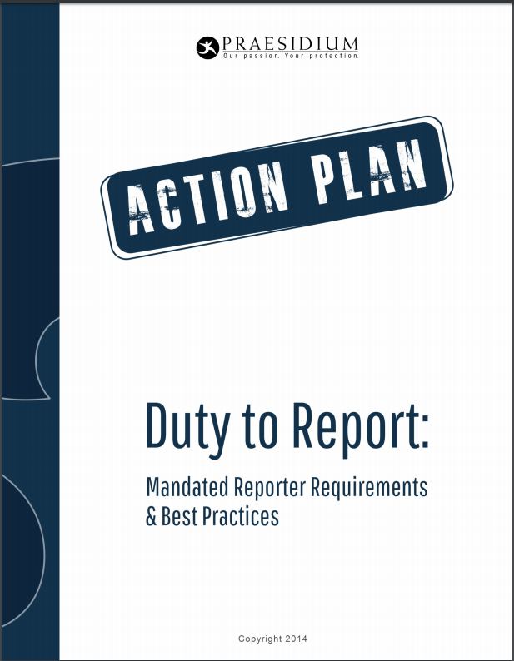
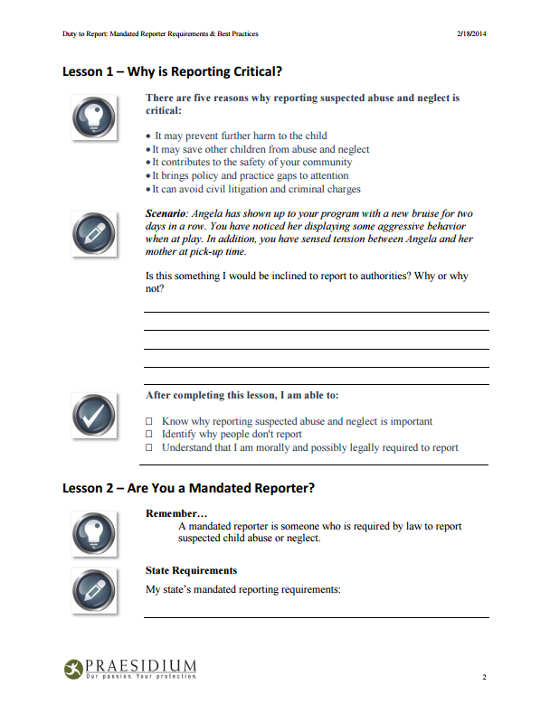
Courses Overview
Print a copy of the Action Plan to take notes while completing the course.
Notes:
Courses available in English, Spanish and Canadian French
Each courses shows the status of Pending or Completed with completion date

Slide 11
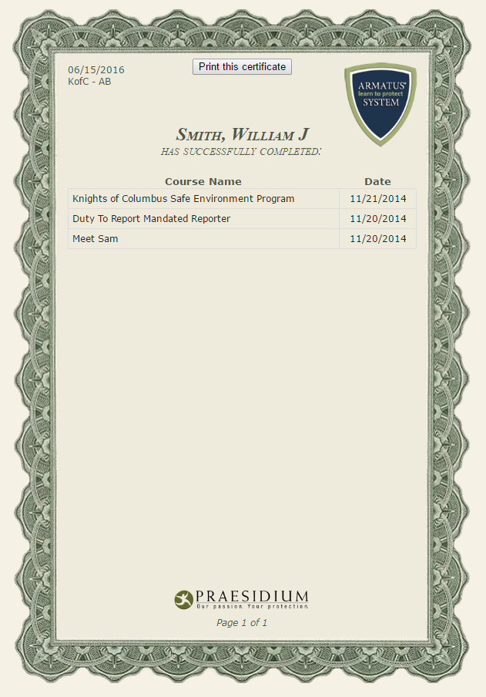
Courses Overview
Print or save your course completion certificate
Your Name Here
Notes:
Courses available in English, Spanish and Canadian French
Each courses shows the status of Pending or Completed with completion date

Slide 12
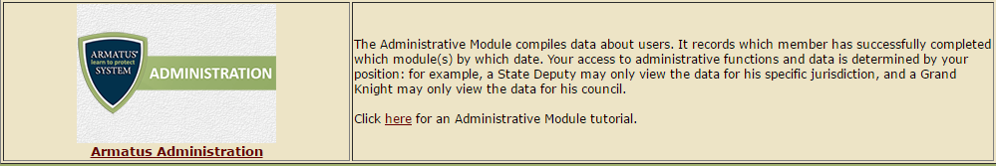
Monitoring Compliance
Monitor compliance through the Administrative Module
Notes:
Knights without access will not see this link.
Who does have access:
State Deputies
Grand Knights
State Advocates
State Squire Chairman (disclose?)
Login with the same credentials used to access training.

Slide 13
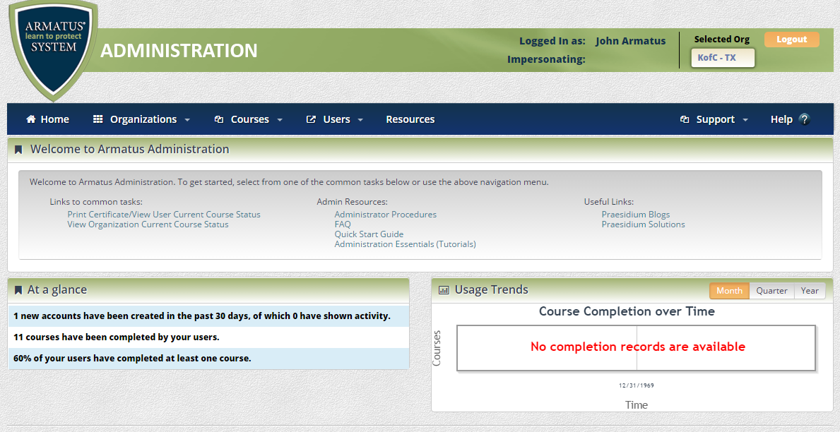
Monitoring Compliance Dashboard

Slide 14
Monitoring Compliance Dashboard

Slide 15
Monitoring Compliance Dashboard

Slide 16
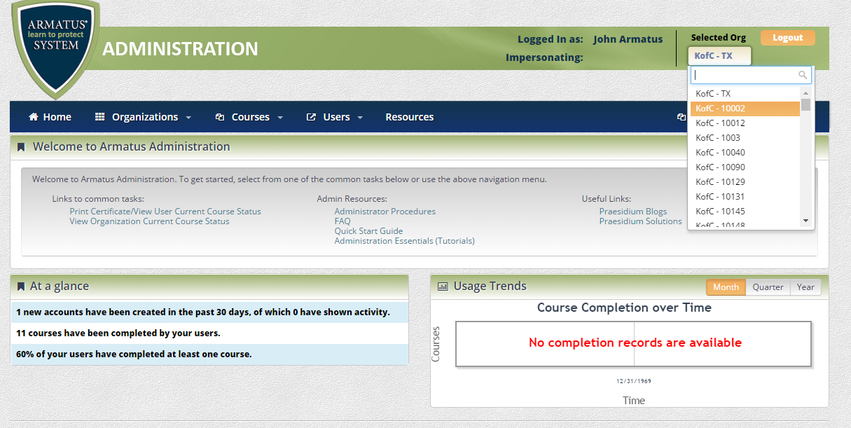
Monitoring Compliance Dashboard

Slide 17
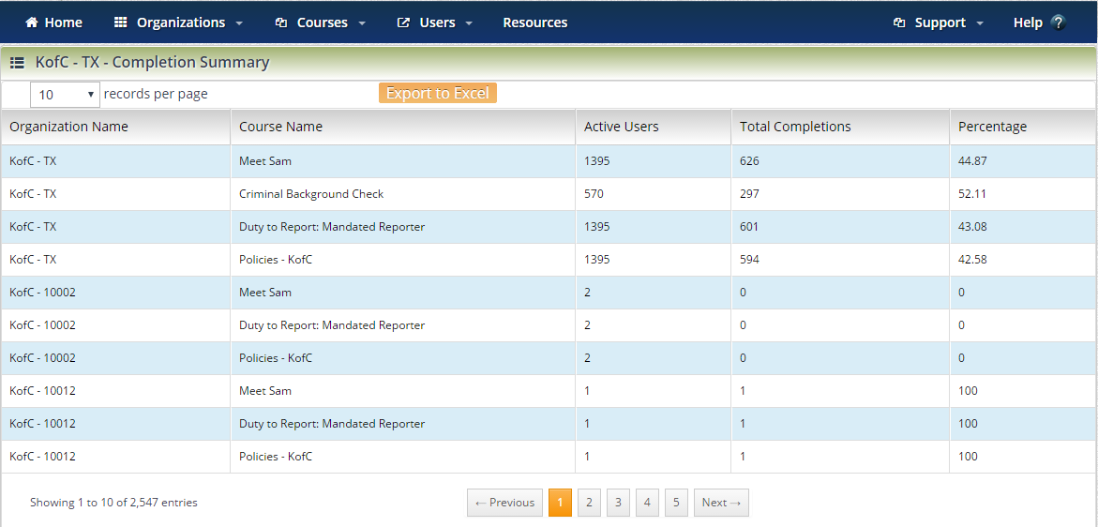
Monitoring Compliance View Completion Summary

Slide 18
Monitoring Compliance View Completion Summary

Slide 19
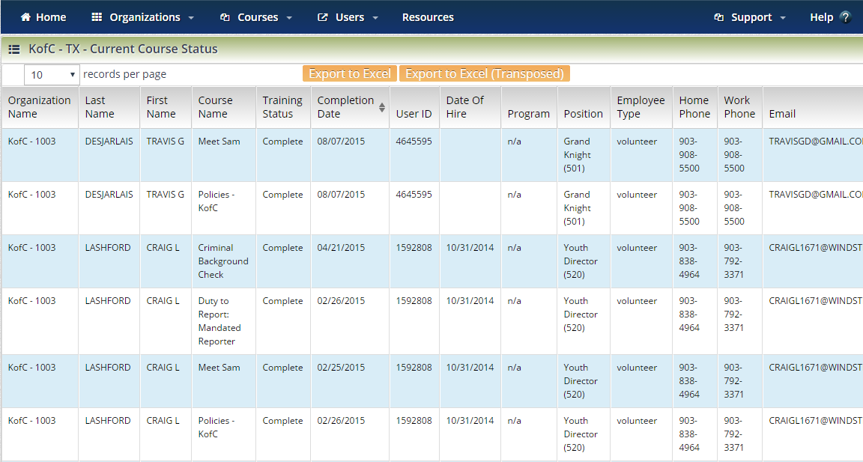
Monitoring Compliance Organization – Current Course Status

Slide 20
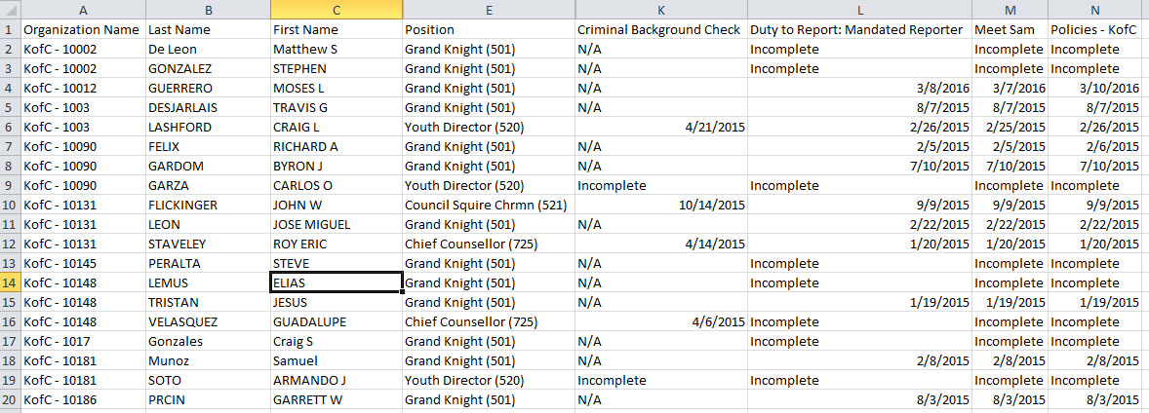
Monitoring Compliance Organization – Current Course Status

Slide 21
Armatus Support
Support Hours
Monday – Friday
8:00 am – 5:00 pm CT
Contact Information
Email support@PraesidiumInc.com
Phone 800-743-6354

